Slide 1

Containers
Faruk Çelik
Sr Technical Evangelist Azure
Microsoft Türkiye
@faruk_celik_

Slide 2
The tension between developers and IT
Developers need to create applications at a competitive rate without worrying about IT
New applications run smoothly on developer’s machines, but malfunction in traditional IT server
Developer productivity and application innovation become suspended
IT needs to manage servers and maintain compliance with little disruption
IT unsure of how to integrate unfamiliar applications, require help from developers
IT is unable to focus on server protection and application compliance
Developers
IT
How do you empower developers to create innovative applications at a competitive rate without disrupting IT’s ability to manage servers and maintain control?
Containers.

Slide 3
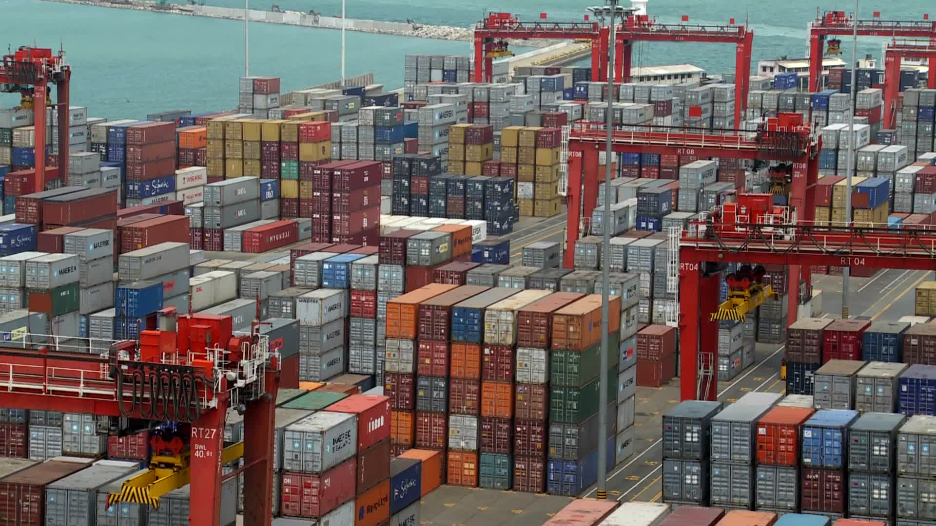
Containers in a ShippingYard

Slide 4
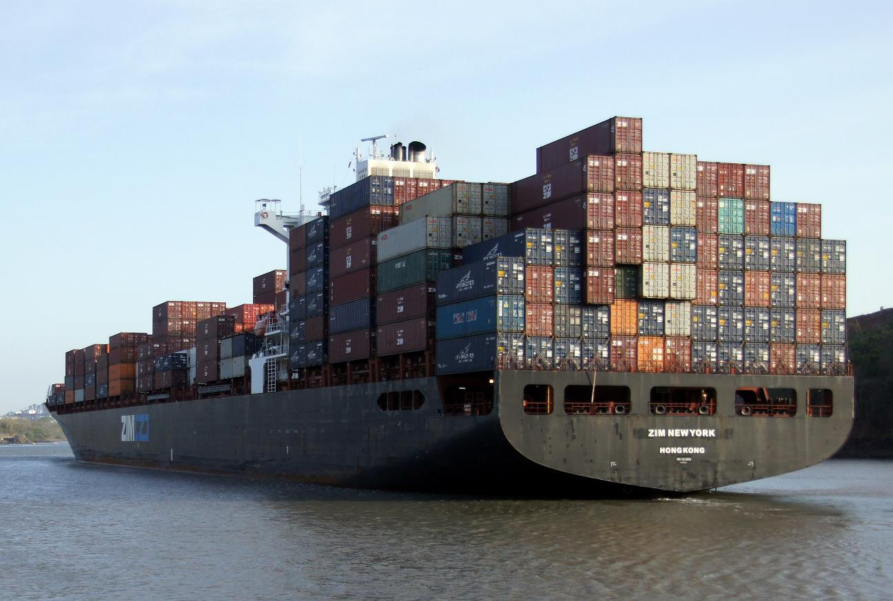
Containers in Ships :

Slide 5
Containers A new approach to build, ship, deploy, and instantiate applications
Applications traditionally built and deployed onto physical systems with 1:1 relationship
New applications often required new physical systems for isolation of resources
Package and run apps within
Containers
Physical
Physical/Virtual
Higher consolidation ratios and better utilization
Faster app deployment than in a traditional, physical environment
Apps deployed into VMs with high compatibility success
Apps benefited from key VM features i.e. Live migration, HA
Key Benefits
Further accelerate of app deployment
Reduce effort to deploy apps
Streamline development and testing
Lower costs associated with app deployment
Increase server consolidation
Virtual
Notes:
When it comes to applications, historically, IT administrators deployed with a 1:1 application to server ratio. When a new application was required by the business, it was deployed onto a newly provisioned physical system, to ensure no conflicts with existing applications and workloads. This resulted in a huge number of physical servers, all with very low utilization.
Fast forward to a more modern datacenter, where virtualization is now prevalent, and you’ll find significantly higher consolidation ratios, much greater utilization and significantly accelerated app deployment speeds as administrators deploy applications in minutes, compared with hours, days or weeks in a purely physical datacenter.
Compared with applications that ran on individual physical servers, the compatibility of those same apps to run inside virtual machines was typically very high. After all, the virtual machine just presents virtual hardware to the same operating system that was running in the physical world. The only consideration being, if that application or workload has a requirement for a specific piece of hardware, such as a PCI-E card, that couldn’t be virtualized and presented through to the guest operating system. In addition, once that application was encapsulated inside the virtual machine, it benefited from higher levels of redundancy, and also mobility, through features such as live migration.
There is however, a new and increasingly popular way to build, ship, deploy and instantiate applications. Containers can further accelerate application deployment and streamline the way IT operations and development teams collaborate to deliver applications to the business.
But what are containers? Well, to give the computer science definition, containers are an operating system-level isolation method for running multiple applications on a single control host. With developers building, and then packaging their applications into containers, and providing them to IT to run on a standardized platform, it reduces the overall effort to deploy applications, and can streamline the whole dev and test cycle, ultimately reducing costs. As containers can run on a host OS which itself could be physical or virtual, it provides IT with flexibility, and the opportunity to drive an increased level of server consolidation, all whilst maintaining a level of isolation that allows many containers to share the same host operating system.

Slide 6
Why Containers? Applications are fueling innovation in today’s cloud-mobile world
Containers unlock ultimate productivity and freedom
Enable ‘write-once, run-anywhere’ apps
Can be deployed as multi-tier distributed apps in IaaS/PaaS models
Containers offers powerful abstraction for microservices
DevOps
Developers
Enhances familiar IT deployment models
Provide standardized environments for development, QA, and production teams
Abstract differences in OS distributions and underlying infrastructure
Higher utilization and compute density
Rapid scale-up and scale-down in response to changing business needs
Integrate people, process, and tools for an optimized app development process
Operations focus on standardized infrastructure
Developers focus on building, deploying and testing apps
Operations
Notes:
But why do we need containers? What do containers provide that virtual machines can’t? Who is driving the momentum behind containers?
Applications are fueling the innovation in today’s cloud-mobile world, and developers hold the keys to the power of those applications. The more streamlined and efficient the process for developers to build and deliver their applications, the faster that more powerful applications can reach the business. This however, has to work across both the developers, and IT who hold the keys when it comes to the infrastructure that the applications will run on.
For the developers, containers unlock huge gains in productivity, and freedom – the ability to build an application, package within a container, and deploy, knowing that wherever you deploy that container, it will run without modification, whether that is on-premises, in a service provider’s datacenter, or in the public cloud, using services such as Microsoft Azure. These containers don’t have to be deployed independently – developers can model complex multi-tier applications, with each tier packaged within a container, and these can be distributed across IaaS and PaaS models, again, increasing the overall surface area that the developer can aim for when releasing their application. This powerful abstraction of microservices provides developers with incredible potential to deliver applications more rapidly than ever before. They can’t however, do it without the Operations’ team support.
On the Operations side, they benefit considerably by being able to gain ever higher levels of consolidation for applications and workloads than even virtualization could provide, and in addition, they can put in place a platform that can rapidly scale up and down to meet the changing needs of the business. This standardized platform is easier to manage, yet provides the developers with a consistent environment into which they can simple provide their app, and hit ‘run’.
This integration across development and operations is what’s becoming known in the industry as DevOps. DevOps aims to integrate people, process and tools to streamline the application development and deployment process. Ops can focus on providing a standardized infrastructure and a set of resources that can be consumed by the development teams, and developers can focus on designing, building, packaging and testing their applications, utilizing the platform that IT provide.

Slide 7
Containers Overview
Container
Spotlight capabilities
Dependencies: Every application has it’s own dependencies which includes both software (services, libraries) and hardware (CPU, memory, storage).
Virtualization: Container engine is a light weight virtualization mechanism which isolates these dependencies per each application by packaging them into virtual containers.
Shared host OS: Processes in containers are isolated from other containers in user space, but share the kernel with the host and other containers.
Flexible: Differences in underlying OS and infrastructure are abstracted away, streamlining ‘deploy anywhere’ approach.
Fast: Containers can be created almost instantly, enabling rapid scale-up and scale-down in response to changes in demand.
App A Bins/Libraries
App B Bins/Libraries
Host OS w/Container Support
Server
Notes:
Now that we understand a little more about why containers are important to both operations, and developers, it’s important to understand just what is a container.
As you can see from the graphic on the right hand side, at the base we have a server. This could be physical, or virtual, and at this stage, it doesn’t matter. On that server, is a host operating system, which, for the purpose of a containers discussion, has container support within the kernel.
If you think about an application, each app tends to have it’s own dependencies. This could include software, such as services, or libraries, or it could have hardware dependencies, such as CPU, memory, or storage. The container engine that exists within the host OS is essentially a lightweight virtualization mechanism which isolates these dependencies on an application by application basis, by packaging them into virtual containers.
The differences in underlying OS and infrastructure are abstracted away – as long as the base image is consistent, the container can be deployed and run anywhere, which for developers, is incredible attractive.
These containers run as isolated processes in user space, on the host operating system, sharing the kernel with other containers. These containers can be created also instantly, which unlocks rapid scale-up and scale-down scenarios in response to changes in demand from the business.

Slide 8
Containers How do they differ from virtual machines?
Virtual Machine
Spotlight capabilities
Dependencies: Each virtualized app includes the app itself, required binaries and libraries and a guest OS, which may consist of multiple GB of data.
Independent OS: Each VM can have a different OS from other VMs, along with a different OS to the host itself.
Flexible: VMs can be migrated to other hosts to balance resource usage and for host maintenance, without downtime.
Secure: High levels of resource and security isolation for key virtualized workloads.
App A Bins/Libraries
App B Bins/Libraries
Guest OS
Guest OS
Hypervisor
Server
Notes:
But how do these containers differ from VMs?
Well, if you think about a VM, each VM typically includes the app itself, required binaries and libraries and a guest OS, which may consist of multiple GB of data. This runs on top of a hypervisor, and consumes a slice of resources from the underlying host operating system. One advantage of the virtualization approach, is that the virtual machines can contain different guest operating systems to one another, and to the host operating system, which provides considerable flexibility and high utilization. In addition, virtual machines can be flexibly migrated from host to host, preserving state, and granting administrators with considerable flexibility, especially in scenarios such as resource optimization and maintenance. Virtual machines also offer very high levels of isolation, both resource and security, for key virtualized workloads.

Slide 9
Containers and virtual machines Deployment options suited to many scenarios
Virtual Machine
Spotlight capabilities
Container
Containers in VMs: By combining containers with VMs, users can deploy multiple, different VM operating systems, and inside, deploy multiple containers within those guest OSs.
By combining containers with VMs, fewer VMs would be required to support a larger number of apps.
Fewer VMs would result in a reduction in storage consumption.
Each VM would support multiple isolated apps, increasing overall density.
Flexible: Running containers inside VMs enables features such as live migration for optimal resource utilization and host maintenance.
App A Bins/Libraries
App A Bins/Libraries
App B Bins/Libraries
Guest OS
Guest OS w/ Container Support
Hypervisor
Server
Notes:
You can however, achieve a ‘best-of-both worlds’ approach.
Containers run on a host OS, but that host OS doesn’t need to be a physical host. By combining containers with VMs, users can deploy multiple, different VM operating systems, and inside, deploy multiple containers within those guest OSs.
By combining containers with VMs, fewer VMs would be required to support a larger number of apps and fewer VMs would result in a reduction in storage consumption.
Each VM would support multiple isolated apps, albeit sharing the same guest operating system for the base image, but increasing overall density. This provides IT with considerable flexibility, as running containers inside VMs enables features such as live migration for optimal resource utilization and host maintenance.

Slide 10
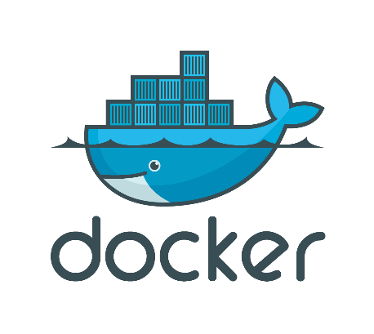

Demo : Containers on Linux

Slide 11
Windows Server Containers Anatomy and key capabilities
Container A
Container B
Container C
Spotlight capabilities
Build: Developers will use familiar development tools, such as Visual Studio, to write apps to run within containers.
By building modular apps leveraging containers, modules can scale independently, and be updated on independent cadences.
Run: Container capabilities built into Windows Server
Manage: Deploy and manage containers using PowerShell, or using Docker.
Resources: Define CPU and memory resources per container along with storage and network throughput.
Network: Provide NAT or DHCP/static IP for network connectivity.
Web tier
App tier
DB tier
LOB app (+Binaries)
LOB app (+Binaries)
LOB app (+Binaries)
Libraries (Shared across containers)
Libraries
Host OS w/Container Support
Server (Physical or Virtual)
Notes:
So what are some of the core Windows Server container capabilities.
The first key takeaway, is that there is core functionality for containers, supported natively within the kernel, and they will be available in the next release of Windows Server.
Developers will use familiar development tools, such as Visual Studio, to write apps to run within containers. Instead of trying to backport existing applications, by building modular apps leveraging containers, modules can scale independently, and be updated on independent cadences, providing the developer with much greater flexibility and speed.
Applications can rely on other packages to provide core functionality. As you can see from the graphic, there are 2 containers that are sharing a number of libraries. In addition, when packaging, the packages also depend on a base package which describes the underlying operating system, such as Server Core, which has a large number of APIs that Windows supports, such as .NET, IIS etc. Nano Server is another, however this has a much smaller surface, that will target apps that have been written from the ground up, with the cloud in mind.
Containers are isolated behind their own network compartment. This can be provided a NAT DHCP or Static IP. Each container has an independent session namespace, which helps to provide isolation and additional security. The kernel object namespace is isolated per container.
Each container also has access to certain CPU and memory resources, along with storage and network capacity – these are controlled by the administrator, and ensures predictable and guaranteed control of processes.
These containers can be managed using tools such as PowerShell, or using the Docker management tools.

Slide 12

Windows Server Containers Creation, deployment, and management
Developers update, iterate, and deploy updated containers
Physical/Virtual Servers
2
3
Operations collaborates with developers to provide app metrics and insights
Developers build and test apps in containers, using development environment i.e. Visual Studio
Operations automates deployment and monitors deployed apps from central repository
1
2
Containers pushed to central repository
Notes:
So what does a lifecycle look like?
Firstly, developers build and test their applications, in containers, on their own box. This could be using a development environment like Visual Studio, or one from a 3rd party. You’ll see in this case, there is a couple of different containers, perhaps representing 2 tiers of an application or workload.
Once completed, these containers are pushed to central repository. This could be a Docker repository, which you’ll learn more about later.
Operations automates deployment of the containers, from this central repository, to the target machines, which could be physical or virtual. They continue to monitor the containers…
…and collaborate with developers to provide them with insight and monitoring metrics which help the development teams gain insight into the usage of the applications.
This could be used to drive an update to a particular container, which, with the developers perform on their own boxes, iterate a version, and deploy the updated version to the central repository, which in turn, is then used to update the existing deployed containers. They could also, if they wanted, to roll it back to a previous version. Containers provides considerable flexibility in this space.

Slide 13


Docker integration Joint strategic investments to drive containers forward
Docker: An open source engine that automates the deployment of any application as a portable, self-sufficient container that can run almost anywhere.
Partnership: Enable the Docker toolset to manage multi-container applications using both Linux and Windows containers, regardless of the hosting environment or cloud provider.
Customer
Datacenter
Dockerized app
Windows Server
Container
Linux Container
Run anywhere
Microsoft
Azure
Service
Provider
Docker
Investments in the next wave of Windows Server
Open source development of the Docker Engine for Windows Server
Azure support for the Docker Open Orchestration APIs
Federation of Docker Hub images into the Azure Gallery and Portal
Strategic investments
Notes:
We’ve mentioned Docker a number of times already – what is Docker?
At a high level, Docker is an open source engine that automates the deployment of any application as a portable, self-sufficient container that can run almost anywhere.
Back in June 2014, Microsoft Azure added support for Docker containers on Linux VMs, enabling the broad ecosystem of Dockerized Linux applications to run within Azure’s industry-leading cloud.
In October 2014, Microsoft and Docker Inc. jointly announced bringing the Windows Server ecosystem to the Docker community, through investments in the next wave of Windows Server, open-source development of the Docker Engine for Windows Server, Azure support for the Docker Open Orchestration APIs and federation of Docker Hub images in to the Azure Gallery and Portal.
Many customers are running a mix of Windows Server and Linux workloads and Microsoft Azure offers customers the most choice of any cloud provider. By supporting Docker containers on the next wave of Windows Server, we are excited to make available Docker open solutions across both Windows Server and Linux. Applications can themselves be mixed; bringing together the best technologies from the Linux ecosystem and the Windows Server ecosystem. Windows Server containers will run in your datacenter, your hosted datacenter, or any public cloud provider – and of course, Microsoft Azure

Slide 14


Docker integration Joint strategic investments to drive containers forward
Spotlight capabilities
Docker Hub: Huge collection of open and curated applications available for download.
Collaboration: Bring Windows Server containers to the Docker ecosystem to expand the reach of both developer communities.
Docker Engine: Docker Engine for Windows Server containers will be developed under the aegis of the Docker open source project.
Docker client: Windows customers will be able to use the same standard Docker client and interface on multiple development environments.
Docker.exe
Examples:
docker run
docker images
Docker Client
Windows Server
Linux
Docker Remote API
Examples:
GET images/json
POST containers/create
Docker Engine
(Daemon)
Docker Engine
(Daemon)
Windows Server
Container Support
Linux Container
Support (LXC)
Notes:
Docker has done a fantastic job of building a vibrant open source ecosystem based on Linux container technologies, providing an easy user experience to manage the lifecycle of containers drawn from a huge collection of open and curated applications in Docker Hub. We will bring Windows Server containers to the Docker ecosystem to expand the reach of both developer communities.
As part of this, Docker Engine for Windows Server containers will be developed under the aegis of the Docker open source project, where Microsoft will participate as an active community member. Windows Server container images will also be available in the Docker Hub alongside the huge number of Docker images for Linux already available.
Finally, we are working on supporting Docker client natively on Windows Server. As a result, Windows customers will be able to use the same standard Docker client and interface, for management, on multiple development environments

Slide 15
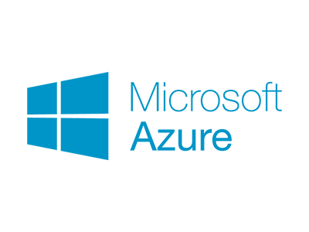
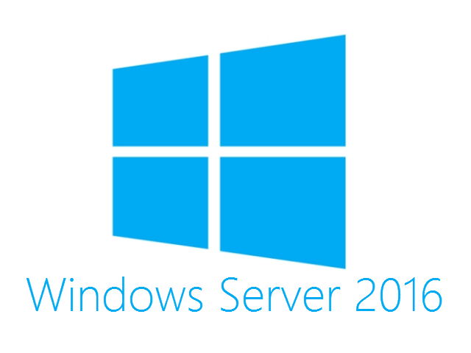
Demo : Containers on Windows Server 2016 TP on Microsoft Azure

Slide 16

Containers are an ideal tool to support:
Distributed compute
Scale out
Databases
Tasks
Web
$$f\left(x\right)$$

Slide 17

Container operating system environments
Nano Server
Server Core
Highly optimized
Born-in-the-cloud applications
Highly compatible
Traditional applications
Notes:
Windows Server and Hyper-V Containers will both take advantage of the smaller installation options for Windows Server: Server Core and (new in Windows Server 2016) Nano Server. Nano Server is a highly-optimized, headless deployment option for Windows Server that runs at a fraction of the Windows Server footprint and is ideal for cloud services. Containers running Server Core are available now with Windows Server 2016 Technical Preview 3.

Slide 18
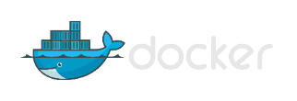






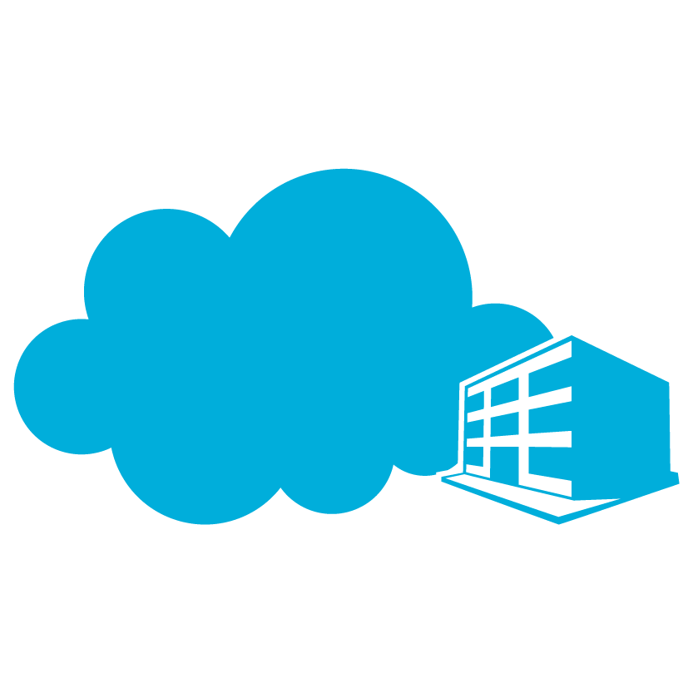

The right tools for you
Container management
PowerShell
Docker
Others
Development environments
Container technologies
Linux
Microsoft cloud
Others…
Azure
On premises
Service Provider
Notes:
Our goal as we bring containers to Windows Server was to offer multiple choices and tools. That means you can manage with PowerShell or with Docker. You will be able to choose in Azure between Linux containers and Windows Server Containers. And you can choose to run containers in Azure, in an on-premises datacenter or in a service provider datacenter. You can also take advantage of familiar tools to build applications.

Slide 19

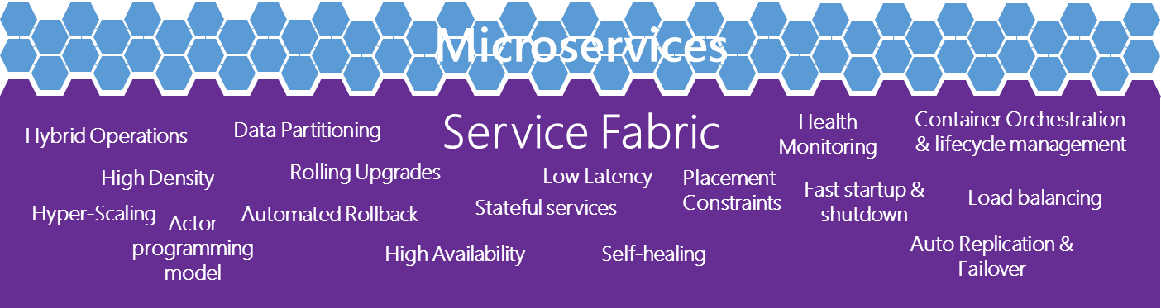
The right tools for you
Virtual Machines
Linux
Development frameworks and languages
Service fabric
PHP
Python
Perl
Go
Node
JavaScript
.Net
C++
Ruby
Win32
Java
Microsoft cloud
Container technologies
Linux
Azure
On premises
Service Provider
Notes:
So it’s important to think of containers as really part of your arsenal – an option just the way that virtual machines are an option.

Slide 20
Demo : Deploy an ASP.Net 5 app to a container running on Microsoft Azure using Visual Studio only

Slide 21
What’s next for containers on Azure

Slide 22



Azure Container Service (in Preview) Orchestration Management
Swarm Compose
Marathon
Cloud
Cloud

Slide 23
Teşekkürler :)

Slide 24
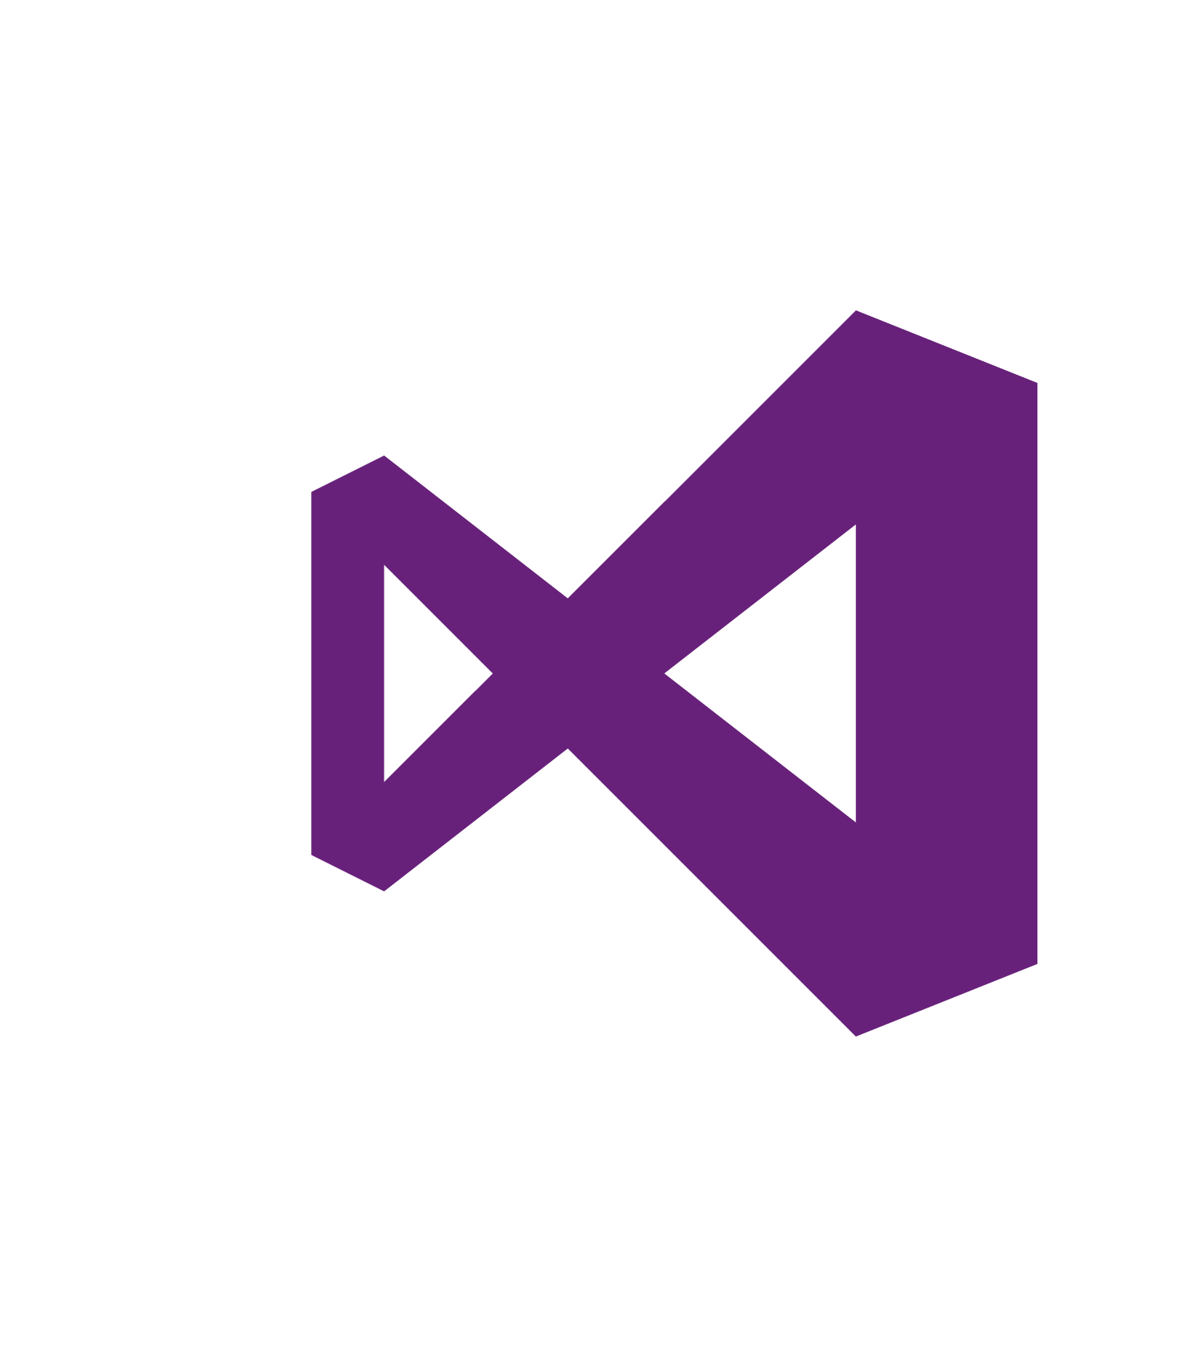
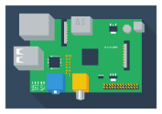
Sorularınızı Türkçe MSDN forumlarımızda cevaplıyoruz :
http://aka.ms/msdntr

